Slide 1
Chemical Reactions and Equations
CHAPTER 1
Part 1-Chemical Equation
Notes:
Lets start with our Chapter 1- that is Chemical Reactions and Equations

Slide 2
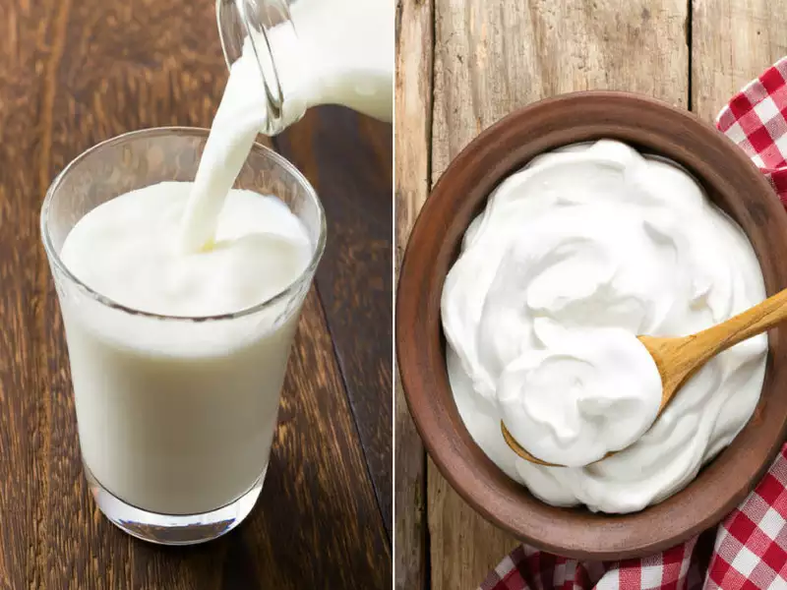
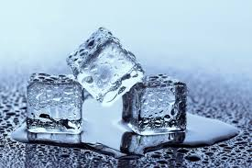
INTRODUCTION
Some substances when mixed form new substances.
Example:
Addition of 1 spoon of curd to lukewarm milk
Melting of ice
After few hours it turns into curd.
Notes:
We come across various situations in our day-to-day life, Lets consider them and think what happens when-
-milk is left at room temperature during summers.
-an iron tawa/pan/nail is left exposed to humid atmosphere.
-grapes get fermented.
-food is cooked.
-food gets digested in our body.
-we respire.
In all the above situations, the nature and the identity of the initial substance have somewhat changed.

Slide 3

CHEMICAL REACTION DEFINITION:
When two or more substances react and form a new substance, it is called as chemical reaction.
i.e. Reactants : Substance that are mixed
Products: the new substance that are formed on account of chemical reaction.
Notes:
From the examples we considered we can say that whenever a chemical change occurs ,a chemical reaction has taken place.
So how do we define a chemical reaction-
When two or more substances react and form a new substance, it is called as chemical reaction.
i.e. Reactants : Substance that are mixed
Products: the new substance that are formed on account of chemical reaction.
Like in the above curd formation example- milk and one spoon of curd is reactant
Final curd is the product

Slide 4
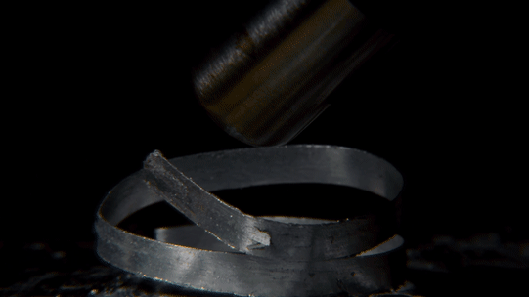
ACTIVITIES RELATED TO CHEMICAL REACTION:
Burning of magnesium ribbon:
Notes:
Let us see the first activity ,here we will try to burn a magnesium ribbon, first we'll clean the ribbon by rubbing it with sandpaper. Now we’ll take a burner or spirit lamp and hold the ribbon with pair of tongs over it. We’ll simultaneously collect the ash produced while the ribbon burns in the tray. We should always keep in mind that the ribbon should not be very close to our eyes.
We observe that magnesium ribbon burns with a dazzling white flame and changes into a white powder. This powder is magnesium oxide. It is formed due to the reaction between magnesium and oxygen present in the air.

Slide 5
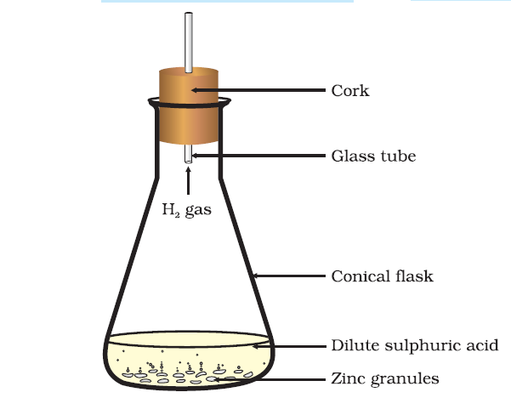
Reacting zinc granules with dilute sulphuric acid
Formation of hydrogen gas by the action of dilute sulphuric acid on zinc
Notes:
Steps to be followed:
Take a few Zinc granules in a conical flask or a test tube.
Add dilute hydrochloric acid or sulphuric acid to this.
Do you observe anything happening around the zinc granules
Touch the conical flask or test tube. Is there any change in its temperature?
Products : Zinc Sulphate and Hydrogen gas
Beaker becomes hot and Hydrogen gas is produced which makes matchstick burn with a pale blue flame, and a popping sound

Slide 6
CHARACTERSTICS OF CHEMICAL REACTION
The conversion of reactants into products in a chemical reaction is often accompanied by some features which can be easily observed easily.
The important characteristics of chemical reactions are:
Evolution of a gas
Formation of a precipitate
Change in color
Change in temperature
Change in state
Notes:
Let me explain you all these characteristics in detail-
First is Evolution of a Gas
Some chemical reactions are characterized by the evolution of a gas.
The chemical reaction between zinc and dilute sulphuric acid is characterized by the evolution of hydrogen gas.
Second
Formation of a precipitate:
Some chemical reactions are characterized by the formation of precipitate. A precipitate is a ‘solid product’ which separates out from the solution during a chemical reaction.
The chemical between potassium iodide and lead nitrate is characterized by the formation of a yellow precipitate of lead iodide.
Change in colour:
Some chemical reactions are characterized by a change in color.
The chemical reaction between citric acid and purple colored potassium permanganate solution is characterized by a change in color from purple to colorless.
Change in temperature:
Some chemical reactions are characterized by a change in temperature.
The chemical reaction between quicklime and water to form slaked lime is characterized by a change in temperature.
Change in state:
Some chemical reactions are characterized by a change in state.
When wax is burned (in the form of wax candle), then water and carbon dioxide are formed.
Now, wax is a liquid whereas carbon dioxide is a gas. This means that during the combustion reaction of wax, the physical state changes from solid to liquid and gas.

Slide 7
CHEMICAL EQUATION
The method of representing a chemical reaction with the help of symbols and formula of the substances involved in it is known as a chemical equation.
A
+
BC
AB
+
C
Products
Reactants
Notes:
The substances which combine or react are known as reactants.
The new substances produced in a reaction are known as products.
A word-equation shows change of reactants to products through an arrow placed between them. The reactants are written on the left-hand side (LHS) with a plus sign (+) between them. Similarly, products are written on the right-hand side (RHS) with a plus sign (+) between them. The arrowhead points towards the products, and shows the direction of the reaction.

Slide 8
EXAMPLE:
Zinc metal reacts with dilute sulphuric acid to form zinc sulphate and hydrogen gas.
Zinc
+
Sulphuric acid
Zinc sulphate
+
Hydrogen
This is known as word equation. Putting the symbols and formula of all the substances in the above word equation, we get the following chemical equation:
Zn
+
H₂SO₄
ZnSO₄
+
H₂
Reactants
Products
Notes:
In the above example we see zinc metal reacts with sulphuric acid here these are the reactants which once mixed produces the product zinc sulphate and releases hydrogen gas.

Slide 9
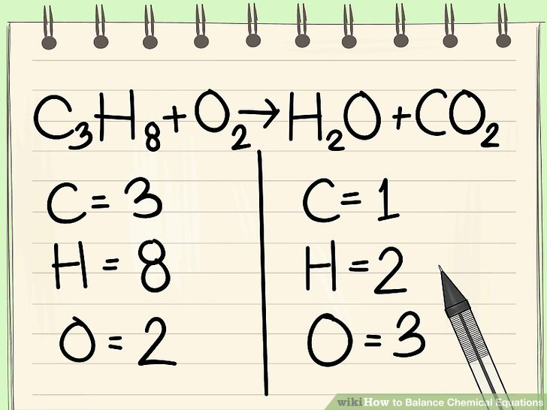
BALANCED CHEMICAL EQUATION
By conservation of mass :
No. of atoms should be equal in both reactants and products side .
A balanced chemical equation has an equal number of atoms of different elements in the reactants and products.
An unbalanced chemical equation has an unequal number of atoms of one or more elements in the reactants and products
Notes:
Steps:
1.Write down your given equation.
For this example, you will use:C₃H₈ + O₂ --> H₂O + CO₂
This reaction occurs when propane (C₃H₈) is burned in the presence of oxygen to produce water and carbon dioxide.
2.Write down the number of atoms per element.
Do this for each side of the equation. Look at the subscripts next to each atom to find the number of atoms in the equation. When writing it out, it's a good idea to connect it back to the original equation, noting how each element appears.^{[2]}For example, you have 3 oxygen atoms on the right side, but that total results from addition.
Left side: 3 carbon (C3), 8 hydrogen (H8) and 2 oxygen (O2).
Right side: 1 carbon (C), 2 hydrogen (H2) and 3 oxygen (O + O2).
3.Save hydrogen and oxygen for last, as they are often on both sides.
Hydrogen and oxygen are both common in molecules, so it's likely that you'll have them on both sides of your equation. It's best to balance them last.You'll need to recount your atoms before balancing the hydrogen and oxygen, as you'll likely need to use coefficients to balance the other atoms in the equation.
4.Start with single elements.
If you have more than one element left to balance, select the element that appears in only a single molecule of reactants and in only a single molecule of products. This means that you will need to balance the carbon atoms first.
5.Use a coefficient to balance the single carbon atom.
Add a coefficient to the single carbon atom on the right of the equation to balance it with the 3 carbon atoms on the left of the equation.C₃H₈ + O₂ --> H₂O + 3CO₂
The coefficient 3 in front of carbon on the right side indicates 3 carbon atoms just as the subscript 3 on the left side indicates 3 carbon atoms.
In a chemical equation, you can change coefficients, but you must never alter the subscripts.
6.Balance the hydrogen atoms next. Since you have balanced all atoms besides the hydrogen and oxygen, you can address the hydrogen atoms. You have 8 on the left side. So you'll need 8 on the right side. Use a coefficient to achieve this.C₃H₈ + O₂ --> 4H₂O + 3CO₂
On the right side, you now added a 4 as the coefficient because the subscript showed that you already had 2 hydrogen atoms.
When you multiply the coefficient 4 times by the subscript 2, you end up with 8.
The other 6 atoms of oxygen come from 3CO₂.(3x2=6 atoms of oxygen+ the other 4=10)
7.Balance the oxygen atoms. Remember to account for the coefficients that you've used to balance out the other atoms. Because you've added coefficients to the molecules on the right side of the equation, the number of oxygen atoms has changed. You now have 4 oxygen atoms in the water molecules and 6 oxygen atoms in the carbon dioxide molecules. That makes a total of 10 oxygen atoms. Add a coefficient of 5 to the oxygen molecule on the left side of the equation. You now have 10 oxygen atoms on each side.
C₃H₈ + 5O₂ --> 4H₂O + 3CO₂.
The carbon, hydrogen, and oxygen atoms are balanced. Your equation is complete.

Slide 10
CONCLUSION
In this part we saw about-
What is chemical reaction?
Characteristics of chemical reaction?
What is a chemical equation?
How to balance a chemical equation?

